Slide 1

RISE
Choice Pantry
Volunteer Orientation
Welcoming neighbors with dignity, consistency, and care.
NEW VOLUNTEER TRAINING
Volunteer Contact: volunteer@njrise.org | 609-438-3126
Notes:
Welcome volunteers and thank them for choosing to serve at the Rise Choice Pantry.

Slide 2
Why the Choice Pantry Matters
The pantry is more than a place to receive food. It is a place where neighbors are treated with respect and choice.
1
2
3
welcoming first impression
organized pantry flow
dignity-centered support
🤝
Your role
🛒
Client choice
🌱
Community care
Volunteers help make the pantry calm, respectful, and efficient so families can receive support without feeling rushed or judged.
Neighbors select items that fit their household, culture, health needs, and preferences whenever possible.
Every shift helps reduce food insecurity and strengthens trust between Rise and the community.
Rise Choice Pantry Volunteer Orientation
1
Notes:
Anchor volunteers in the mission: dignity, choice, consistency, and teamwork.

Slide 3
Today’s Orientation
What every pantry volunteer should know before serving.
1
2
3
Arrive prepared
Check in and out
Understand pantry flow
4
5
6
Support clients respectfully
Handle food safely
Know when to ask staff
Rise Choice Pantry Volunteer Orientation
2

Slide 4
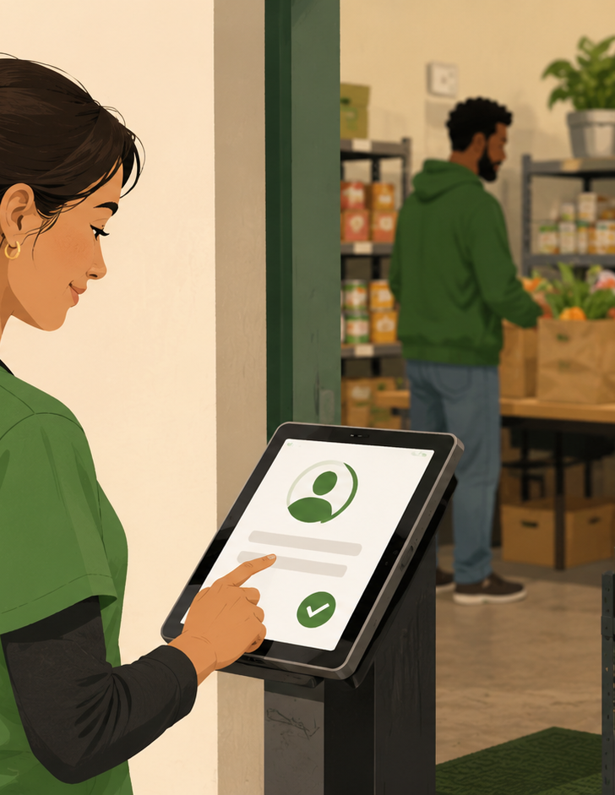
Before Your Shift
A little preparation helps the pantry run smoothly.
Sign up for your specific pantry shift in Galaxy Digital before arriving.
Wear comfortable, closed-toe shoes and clothing suitable for lifting, sorting, and walking.
Bring a water bottle and keep personal items secure and out of work areas.
Arrive on time and check in with the pantry lead before beginning tasks.
Note: If you are not on the roster or the shift appears full, please contact the volunteer coordinator before serving.
Rise Choice Pantry Volunteer Orientation
3

Slide 5
Check-In and Hour Tracking
Hours can only be verified when volunteers check in and out correctly.
📱
Use Causer / Get Connected
✅
Match your sign-up
📄
Verification letters
Check in when you arrive and check out when you leave. Use the app or the on-site kiosk/tablet if available.
Your check-in should match the shift and location you signed up for in the volunteer portal.
Confirmation letters are provided after total required hours are completed and confirmed in the system.
No check-in/out = hours may not be verified. Please ask for help the same day if the app or kiosk is not working.
Rise Choice Pantry Volunteer Orientation
4

Slide 6
How Pantry Service Flows
Your assigned role may change based on the day’s needs. Stay flexible and check with staff.
1
2
3
4
5
Welcome
Guide
Stock
Pack/Carry
Reset
Greet clients warmly and direct questions to staff.
Help keep lines and shopping areas calm and clear.
Restock shelves, produce, and staples as directed.
Assist with bags, carts, and loading when appropriate.
Clean, break down boxes, and prepare for the next shift.
Important: Staff leads manage eligibility, registration, PantrySoft, conflict resolution, and exceptions. Volunteers support the flow.
Rise Choice Pantry Volunteer Orientation
5

Slide 7
Common Volunteer Roles
You may be assigned to one area or moved where help is needed most.
🥫
Shelf restocking
🥕
Produce support
🛍️
Bagging / cart help
Place items neatly, rotate older items forward, and alert staff when shelves are low.
Sort fresh items, remove damaged produce, and keep bins clean and full.
Assist with bags or carts while allowing clients to make their own choices.
📦
Donation sorting
🧹
Clean-up
❓
Greeter support
Separate usable food from damaged, expired, or questionable items and ask staff when unsure.
Wipe surfaces, break down boxes, clear walkways, and reset the pantry for the next service window.
Welcome clients, point them in the right direction, and bring questions to staff.
Rise Choice Pantry Volunteer Orientation
6

Slide 8
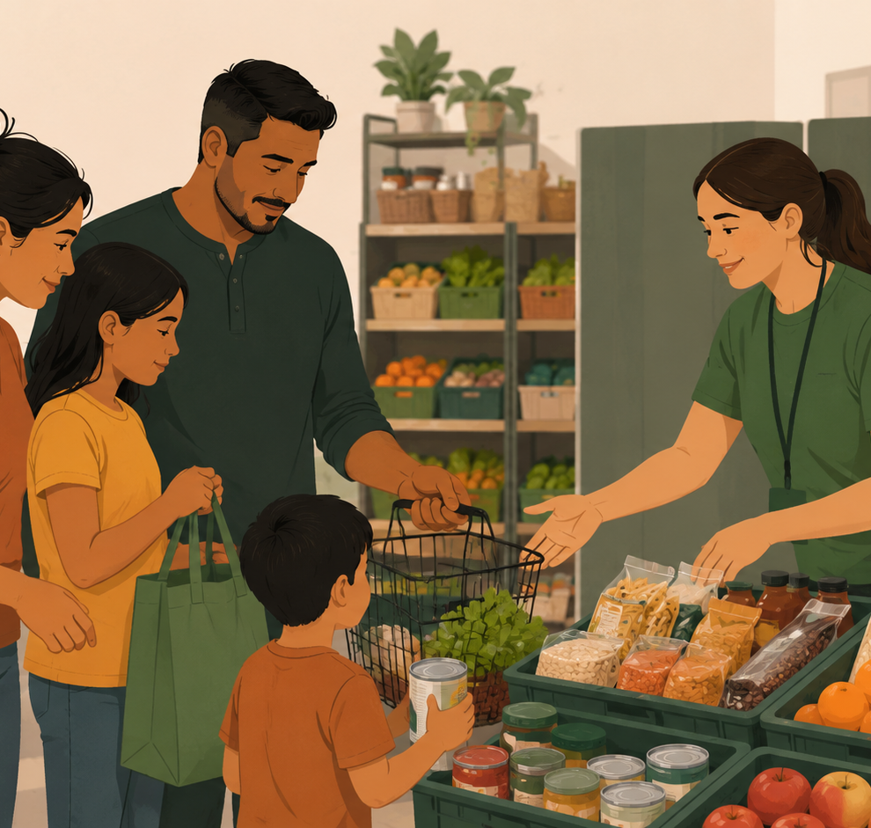
Dignity-Centered Client Support
Small moments of kindness make a big difference.
Use warm, simple greetings: “Good morning,” “Welcome,” “How can I help?”
Avoid comments about how much food someone receives or chooses.
Respect privacy. Do not ask personal questions about income, immigration, family issues, or pantry eligibility.
Use interpreters, bilingual staff, or simple gestures when language is a barrier.
Goal: Help clients feel seen, respected, and never judged.
Rise Choice Pantry Volunteer Orientation
7

Slide 9
Food Safety and Cleanliness
When in doubt, ask staff before using, stocking, or giving out an item.
🧼
Wash or sanitize hands
🧤
Use gloves when directed
🚫
Do not stock questionable items
Wash before handling food, after breaks, after using the restroom, and after touching your face or phone.
Gloves do not replace handwashing. Change gloves if they become torn, dirty, or used for another task.
Damaged, leaking, opened, moldy, or unsafe-looking food should be set aside for staff review.
📅
Check dates and labels
🧊
Protect cold items
👟
Keep walkways clear
Ask staff how to handle best-by dates, expired items, unlabeled items, and dietary/allergen concerns.
Keep refrigerated and frozen items in the correct area. Do not leave cold items out longer than directed.
Prevent slips and trips by clearing boxes, spills, carts, and bags from walking paths.
Rise Choice Pantry Volunteer Orientation
8

Slide 10
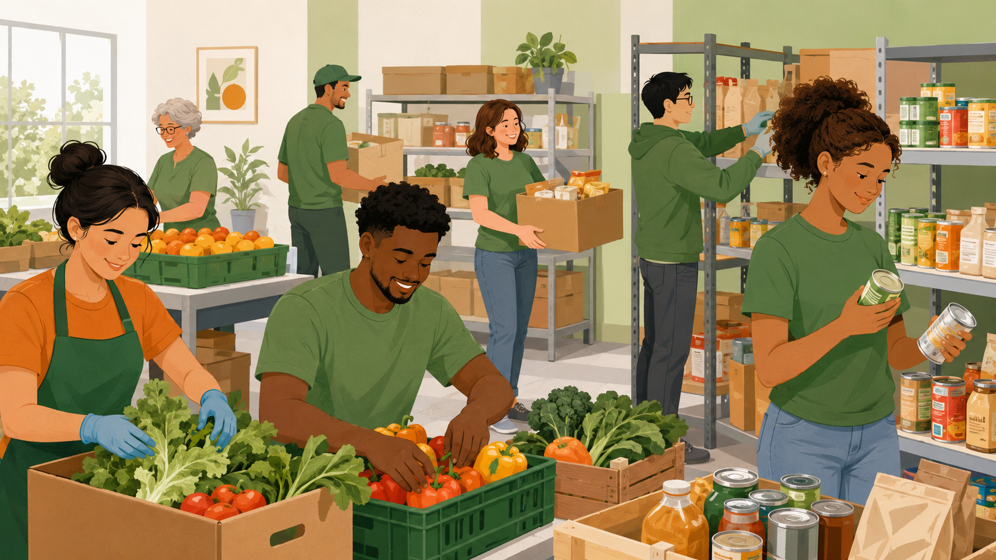
Teamwork During Busy Shifts
Good communication keeps the pantry calm and safe.
Check in with the pantry lead before switching tasks.
Keep aisles clear and move carts slowly through client areas.
Use a calm voice, even when the space feels busy.
Tell staff right away about spills, conflict, injuries, damaged items, or safety concerns.
Be kind to other volunteers. Everyone is learning the flow.
Rise Choice Pantry Volunteer Orientation
9

Slide 11
Boundaries and Confidentiality
Volunteers are trusted helpers. Protecting client privacy is part of the role.
DO
DO NOT
Be friendly and respectful
Bring concerns to staff
Follow your assigned role
Keep client information private
Do not take photos of clients
Do not promise services or exceptions
Do not argue about pantry rules
Do not share client stories publicly
Rise Choice Pantry Volunteer Orientation
10

Slide 12
When to Get Staff Immediately
You are never expected to handle difficult situations alone.
⚠️
Safety issue
🗣️
Client concern
🥫
Food concern
Injury, fall, spill, blocked exit, aggressive behavior, unsafe lifting, or a child left unattended.
A client is upset, confused about rules, asking for an exception, or needing private assistance.
Questionable dates, damaged packaging, temperature concerns, pests, or potential contamination.
Simple rule: pause, stay calm, and find the pantry lead or staff member.
Rise Choice Pantry Volunteer Orientation
11

Slide 13
End-of-Shift Closeout
Finish strong so the next team starts with a clean, organized space.
Check with the pantry lead before leaving.
Return tools, carts, gloves, aprons, and supplies to their designated areas.
Break down boxes and remove trash or recycling as directed.
Wipe surfaces and restock any assigned areas if time allows.
Check out in Causer/Get Connected before you leave.
Rise Choice Pantry Volunteer Orientation
12

Slide 14
Volunteer Acknowledgment
Before serving, each volunteer should be able to say:
✓
I know how to check in and out for verified hours.
✓
I understand that clients deserve privacy, dignity, and choice.
✓
I will follow staff direction and ask when unsure.
✓
I will keep the pantry safe, clean, and welcoming.
Rise Choice Pantry Volunteer Orientation
13

Slide 15
Items to Customize Before Final Use
These details should be confirmed by the pantry lead or leadership team.
⏰
Current pantry hours
📍
Site logistics
👥
Staff contacts
Distribution days, evening pantry dates, holiday closures, and volunteer arrival times.
Parking, entrance, restrooms, break area, personal item storage, and emergency exits.
Pantry lead, volunteer coordinator, backup contact, and emergency protocol.
🧾
PantrySoft/client process
🥫
Food policy specifics
📱
Tech screenshots
What volunteers may assist with versus what must remain staff-only.
Date guidelines, donation acceptance, allergen labeling, refrigeration rules, and disposal process.
Add your real Galaxy Digital/Causer screenshots for step-by-step check-in training.
Rise Choice Pantry Volunteer Orientation
14

Slide 16
Thank you for serving with Rise.
Together, we help make the pantry a welcoming place where neighbors can receive support with dignity and care.
Questions? volunteer@njrise.org | 609-438-3126

Slide 17



Staff Directory
Key pantry contacts for support, questions, and day-to-day operations.
Valerie Benites
Juan Cobos
1
2
Volunteer Coordinator
Rise Pantry Operations Coordinator
Volunteer questions, scheduling, sign-ups, and hour tracking.
Pantry flow, daily assignments, food distribution, and operations questions.
Iohann Moreno
Ceseu Andrade Neumann
3
4
Rise Pantry Assistant
Pantry Case Manager
Day-of pantry support, restocking guidance, sorting, and task direction.
Client needs, case management questions, resources, and sensitive concerns.

